Slide 1
Thyroid Detect: Advancing Disease Detection Techniques
Presented by:
Jenis Gundaraniya (20BCP157)
Manav Ukani (20BCP167)

Slide 2
TABLE OF CONTENTS
01
02
03
04
05
06
INTRODUCTION
LITERATURE REVIEW
METHODOLOGY
FINDINGS
CONCLUSION
FUTURE SCOPE

Slide 3
INTRODUCTION
Significance of Thyroid Health:
The thyroid gland plays a pivotal role in regulating various bodily functions, including metabolism, energy production, and temperature control. Optimal thyroid function is essential for maintaining overall health and well-being.

Slide 4
INTRODUCTION
Prevalence and Impact of Thyroid Disorders:
Thyroid disorders are more common than often recognized, affecting a significant portion of the population. Thyroid disease affects about 1 in 10 people in India, mainly women aged 17 to 54, leading to serious health issues.
The extreme stage of thyroid results in cardiovascular complications, increase in blood pressure, maximizes the cholesterol level, depression and decreased fertility.

Slide 5
INTRODUCTION
Role of Technology in Healthcare:
Hyperthyroidism and hypothyroidism are the most prevalent thyroid disorders, disrupting the body's metabolic balance. Leveraging the advancements in technology, particularly Machine Learning in the healthcare industry, holds promise for early disease detection and enhancing quality of life.

Slide 6
OBJECTIVE
This project aims to predict hyperthyroidism and hypothyroidism risk using individual factors. Since, thyroid issues are challenging to forecast, this project aims for early detection and precise diagnosis to help doctors make proper decisions and provide better treatment.

Slide 7
LITERATURE REVIEW
Year | Publication | Title | Author(s) | Purpose | Findings
2021 | Journal of Physics: Conference Series (Vol. 1963, No. 1, p. 012140) | Thyroid Disease Classification Using Machine Learning Algorithms | E. Sonuc | Propose thyroid disease classification using machine learning algorithms | Explored SVM, random forest, KNN, Naive Bayes, Multilayer perceptron; aimed to increase classification accuracy
2020 | Journal of Family Medicine and Primary Care, 9:1470, 06 | Diagnosing Thyroid Disorders: Comparison of Logistic Regression and Neural Network Models | Shiva Borzouei, Hossein Mahjub, NegarAsaad Sajadi, and Maryam Farhadian | Compare logistic regression and neural network models for diagnosing thyroid disorders | Neural network model outperformed logistic regression.

Slide 8
LITERATURE REVIEW
Year | Publication | Title | Author(s) | Purpose | Findings
2019 | Fifth International Conference on Parallel, Distributed and Grid Computing (PDGC) | Interactive Thyroid Disease Prediction System Using Machine Learning Technique | Ankita Tyagi and Ritika Mehra | Develop an interactive prediction system for thyroid disease | Decision trees have best performance.
2018 | International Journal of Engineering and Technology | A Comparative Study of Machine Learning Algorithms on Thyroid Disease Prediction | S. Razia, P. Swathi Prathyusha, N. Krishna, and N. Sumana | Compare various machine learning algorithms for thyroid disease prediction | Decision trees have the best performance.
2016 | The Fourth International Conference on Database and Data Mining | MLTDD: Use of Machine Learning Techniques for Diagnosis of Thyroid Gland Disorder | Izdihar Al-muwaffaq and Zeki Bozkus | Develop a machine learning tool for thyroid disease diagnosis | Overall accuracy of 96.7% and 94.8% for testing.

Slide 9
METHODOLOGY
1. DATA COLLECTION
3. MODEL TRAINING
Gathering comprehensive data including thyroid hormone levels to create a holistic view of the patient's thyroid health.
Training machine learning models using labeled data to teach them how to classify thyroid disease accurately. Rigorous validation ensures the models' effectiveness before real-world application.
2. DATA PREPROCESSING
4. COMPARATIVE MODEL ANALYSIS
Identifying the most relevant data attributes (features) and creating new informative features that enhance the model.
Evaluating and choosing appropriate algorithms, such as Logistic Regression, Random Forest, XGBoost, Support Vector Machine (SVM), etc., based on their performance characteristics for thyroid disease prediction.

Slide 10
DATASET DESCRIPTION
From Garavan Institute in Sydney, Australia
Creator: Ross Quinlan
Approximately the following for each database:
2800 training (data) instances and 972 test instances
29 or so attributes, either Boolean or continuously-valued

Slide 11
DATASET - FEATURES
'Age'
'Sex',
'on thyroxine',
'query on thyroxine',
'on antithyroid medication',
'Sick',
'Pregnant',
'thyroid surgery',
'I131 treatment',
'query hypothyroid',
'query hyperthyroid',
'Lithium',
'Goitre',
'Tumor',
'Hypopituitary',
'Psych',
'TSH measured',
'TSH',
'T3 measured',
'T3',
'TT4 measured',
'TT4',
'T4U measured',
'T4U',
'FTI measured',
'FTI',
'TBG measured',
'TBG',
'Referral source',
'Labels'

Slide 12
DATASET - KEY FEATURES
Age: Age in years
Sex: Gender (M or F)
On Thyroxine: If the patient is currently taking thyroxine (1 or 0)
Thyroid Status: Whether the patient has hypothyroid (1) or hyperthyroid (0) disease
TSH: Produced by the pituitary gland and stimulates the thyroid gland to produce thyroid hormones.
T4: T4 (Thyroxine) is the primary hormone produced by the thyroid gland.
T3: Free triiodothyronine level in nanograms per deciliter
FTI: Gives an estimate of the amount of free, active thyroid hormones in blood.
TBG: Thyroxine-Binding Globulin level in milligrams per deciliter
RT3U: Resin T3 Uptake measures the amount of resin bound to T3 in the blood.

Slide 13
DATA PREPROCESSING
In the data preprocessing phase, we meticulously curated the dataset by
concatenated the datasets for hypothyroid and hyperthyroid
identifying and labeling unlabelled columns,
distinguishing between categorical and numerical data,
addressing any missing values.
Additionally, we explored data transformation techniques, including logarithmic and square root transformations, to enhance the representation of features.
Applying encoding using label encoder, enabled us to convert categorical variables into a format suitable for machine learning models.
To ensure model robustness, we scrutinized for multicollinearity using Variance Inflation Factor (VIF), refining the dataset for accurate and reliable predictions.
Notes:
Multicollinearity refers to a situation in which two or more independent variables in a regression analysis are highly correlated with each other. This can cause issues in statistical analysis, particularly in linear regression models, because it can make it difficult to discern the individual effects of these variables on the dependent variable. In other words, it can lead to unstable and unreliable coefficient estimates.
VIF (Variance Inflation Factor) is a measure used to detect the severity of multicollinearity in a regression analysis. It quantifies how much the variance of the estimated regression coefficients is increased due to multicollinearity. Higher VIF values indicate higher levels of multicollinearity.
Identifying and addressing multicollinearity through techniques like removing one of the correlated variables, transforming variables, or using dimensionality reduction methods can improve the stability and interpretability of statistical models.
- VIF cannot be used on categorical data. Statistically speaking, it wouldn't make sense.
- If you want to check independence between 2 categorical variables you can however run a Chi-square test.
Some VIF Rules:
- VIF starts at 1 and has no upper limit
- VIF = 1, no correlation between the independent variable and the other variables
- VIF exceeding 5 or 10 indicates high multicollinearity between this independent variable and the others
- VIF = 1 → No correlation
- VIF = 1 to 5 → Moderate correlation
- VIF > 10 → High correlation

Slide 14
FINDINGS
CHALLENGE
APPROACH
RESULT
The data was very raw (high variance, skewed, null values) and required a lot of efforts in preprocessing.
These features
Handling Null Values
Data Transformation
Label Encoding
Multicollinearity
VIF Rules
These features are having high correlation: sqrroot_age, sqrroot_T3, sqrroot_TT4, log_T4U, sqrroot_FTI
VIF is significantly reduced after dropping the “sqrroot_TT4” feature with highest VIF.

Slide 15
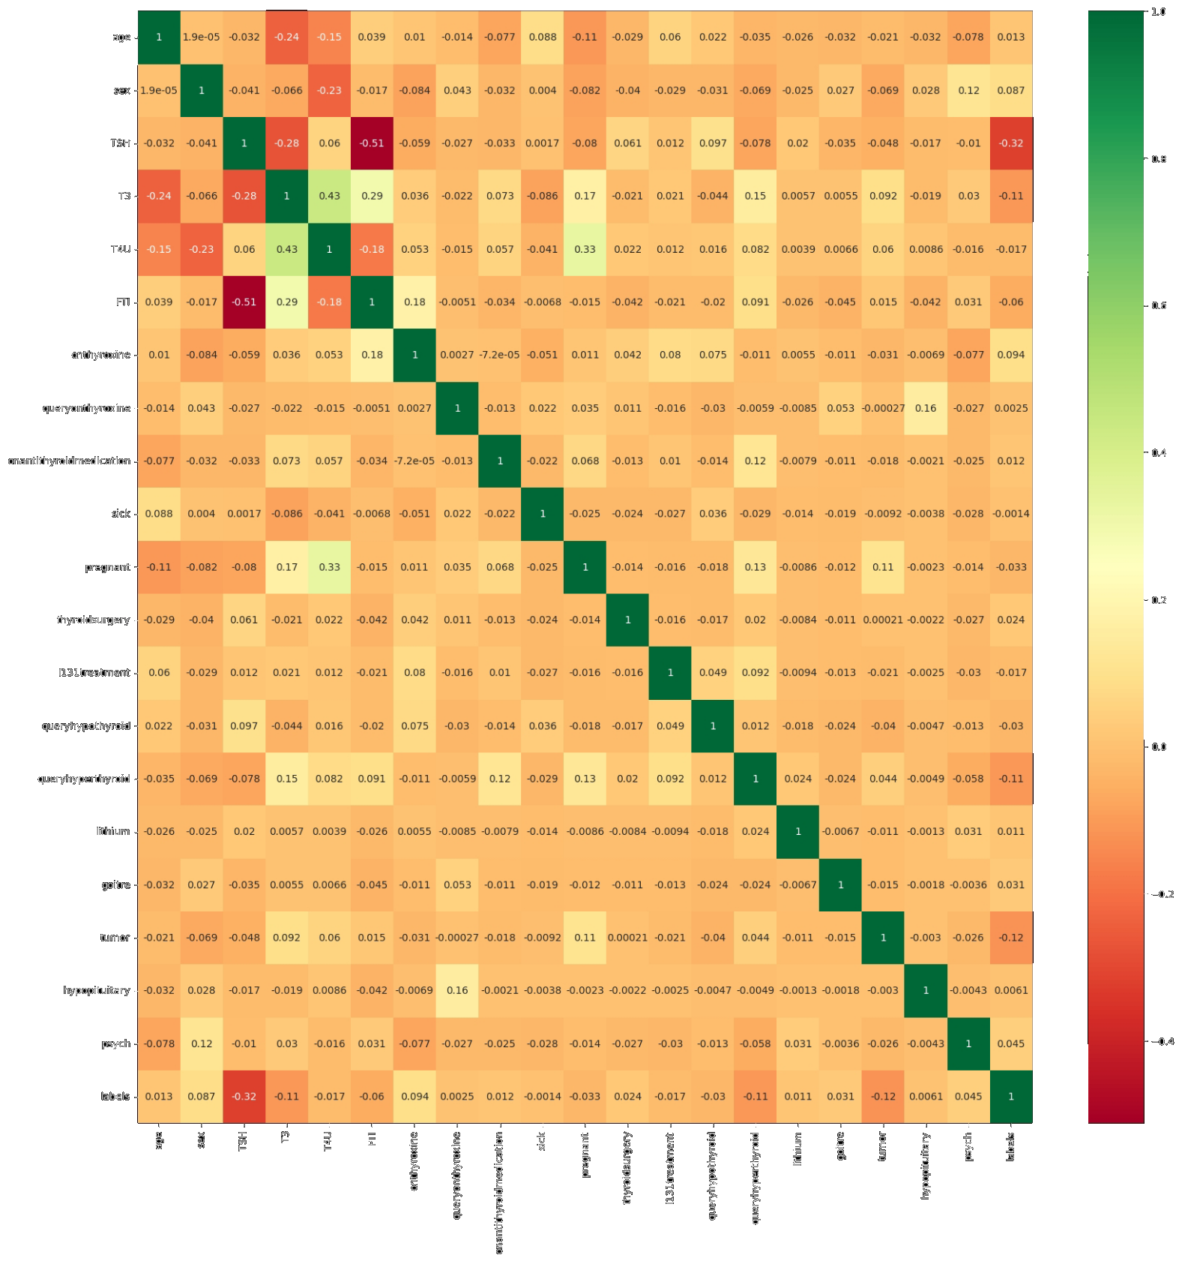
FINDINGS
There is not much correlation between any two features now

Slide 16
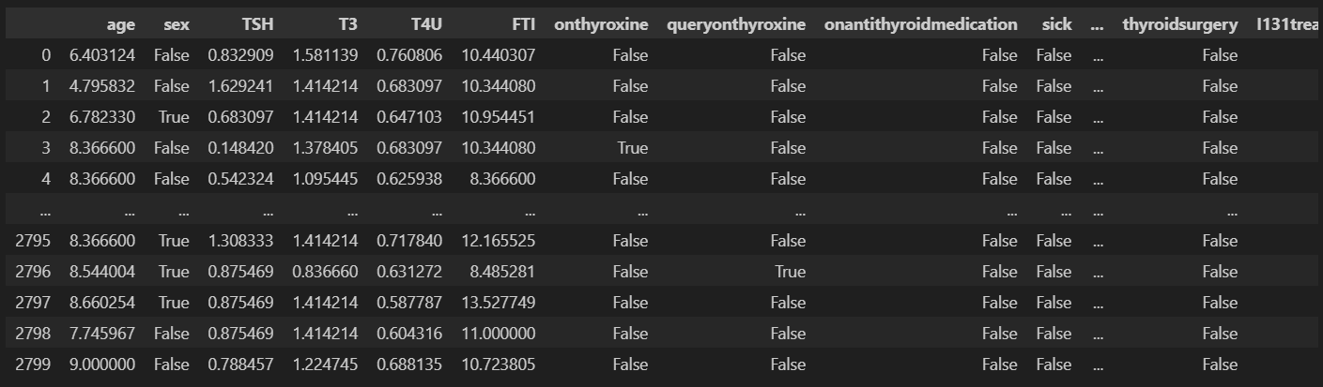
CONCLUSION
After data preprocessing none of the features are correlated now.
The dataset has 2503 instances for negative, 220 for hypothyroid and 77 for hyperthyroid.
We now need to do sampling (since, it’s unbalanced data) and train different models to find an appropriate algorithm with best accuracy and precision.

Slide 17
Minor Project Evaluation 3

Slide 18
Model Comparison
Model | Without Sampling | With Sampling
SVM | 0.921 | 0.920
Decision Tree | 0.984 | 0.983
Random Forest | 0.981 | 0.998
Ensemble (Stacking) | 0.987 | 0.979
The ensemble model using stacking improve predictive accuracy for this problem. The ensemble leverages the strengths of the base estimators.
SVM with an RBF kernel achieved 92% accuracy, indicating it was able to fit the complex decision boundaries in the high-dimensional feature space.

Slide 19
Why ExplainableAI
Transparency in Decision-Making
Building Trust Among Clinicians and Patients
Facilitating Continuous Learning and Model Improvement
Regulatory Compliance and Ethical Considerations

Slide 20
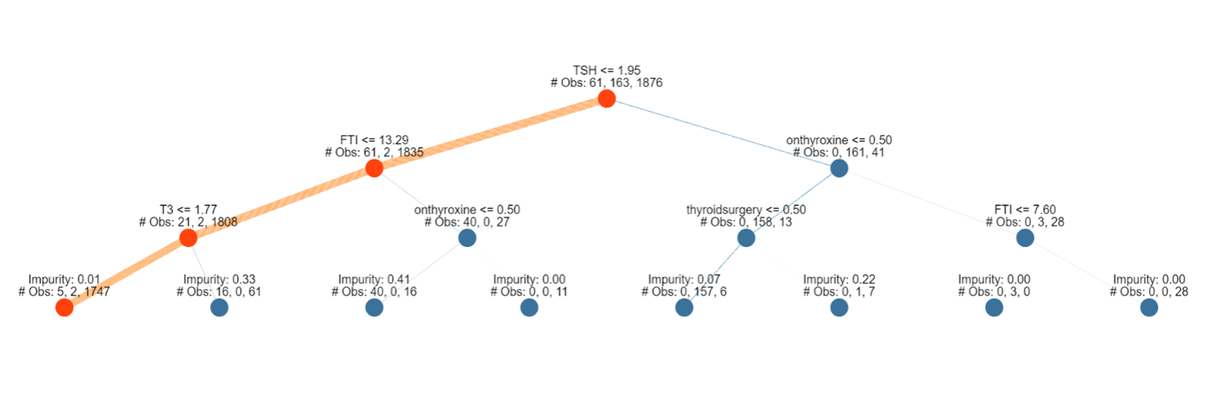
Interpretation using ExplainableAI
Decision Tree XAI

Slide 21
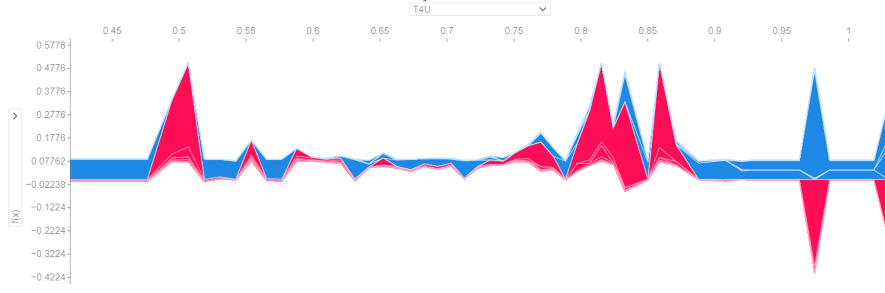
Interpretation using ExplainableAI
SHAP XAI

Slide 22
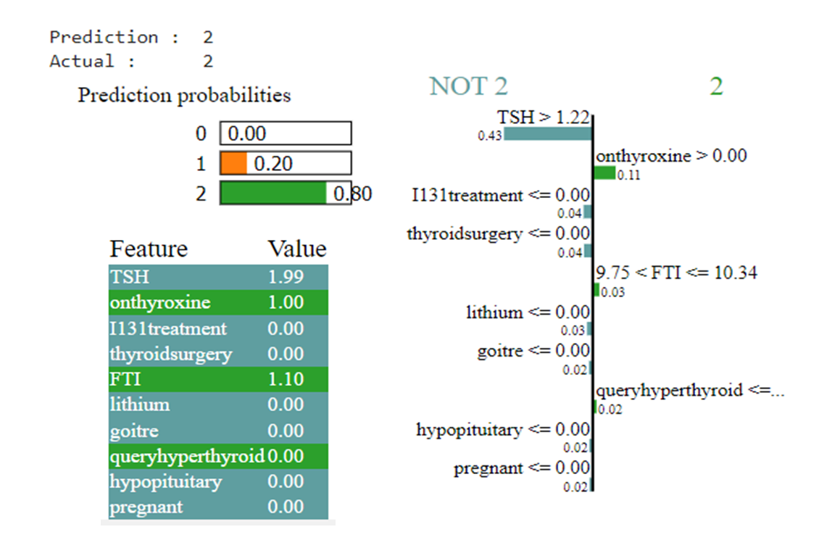
Interpretation using ExplainableAI
LIME XAI

Slide 23
Key Insights
The Random Forest model was analyzed to determine feature importance ranks. The most influential features were found to be:
1. TSH levels
2. Age
3. T4 levels
4. T3 levels
This aligns well with domain knowledge, as TSH, T4, and T3 levels are key clinical biomarkers used to diagnose thyroid disorders. Age is also a critical factor determining disease prevalence.

Slide 24
Conclusion
The machine learning models developed in this project achieved high accuracy in predicting thyroid disease status based on patient information. The ensemble model combining Decision Tree, KNN, and SVM performed the best with 98% accuracy.
Feature importance analysis using Random Forest and decision tree interpretation confirmed the significance of lab tests like TSH, T4, and T3 levels. Local explanations from LIME add transparency and help strengthen trust in the model.

Slide 25
THANK
YOU!

